Slide 1
BASICS OF ELECTRICAL AND ELECTRONICS ENGINEERING
M.RAJA,
ASSISTANT PROFESSOR(Senior Grade),
DEPARTMENT OF EIE,
KONGU ENGINEERING COLLEGE,
PERUNDURAI-638060.

Slide 2
UNIT-1-DC Circuits and AC Circuits
Resistance: Resistors in Series and Parallel - Network Reduction - Star to Delta and Delta to Star Transformations - Ohm‘s Law -Kirchoff’s laws-Voltage and Current Division Rule.
AC Circuits: Alternating (Sinusoidal) Voltage and Current, R.M.S and Average Value, Power Factor, Form Factor and Peak Factor.

Slide 3
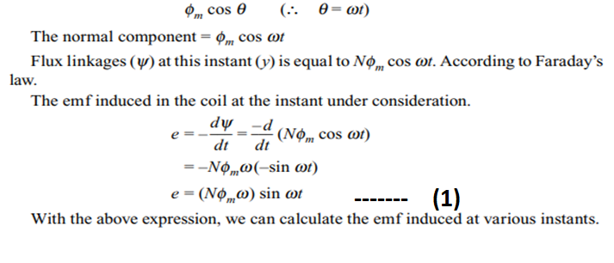
AC FUNDAMENTALS
GENERATION OF ALTERNATIVE EMF
Consider a coil of n turns placed in a magnetic field of maximum value Φ_{m} Webers .
The coil is initially along the reference axis. In this position, the field is perpendicular to the plane of the coil.
Let the coil be rotated in the anticlockwise direction with an angular velocity of ω rad/sec. When the coil is along the reference axis at ωt = 0, it is called as zero e.m.f. position. This is because the movement of the coil at this instant ωt = 0 is along the field.
Let at any instant t sec. the coil takes a position as shown in Fig.
At this instant, the coil makes an angle θ = ωt with the reference axis. At this position, the normal component of the mangnetic flux with respect to the plane of the coil is equal to

Slide 4
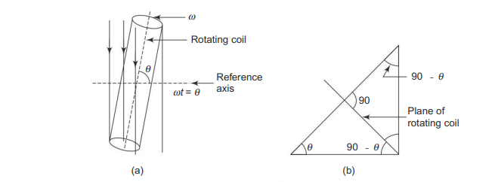

Slide 5
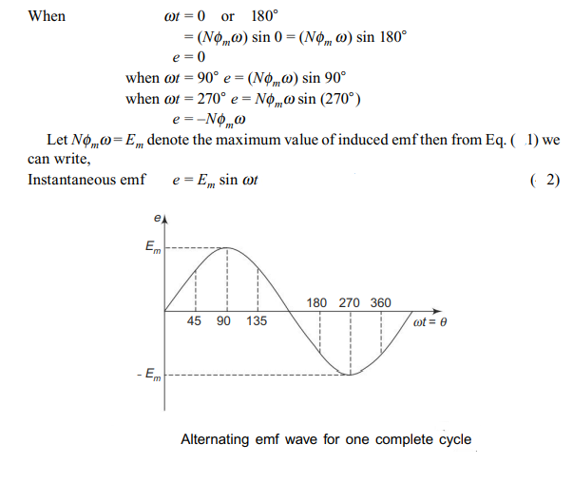

Slide 6
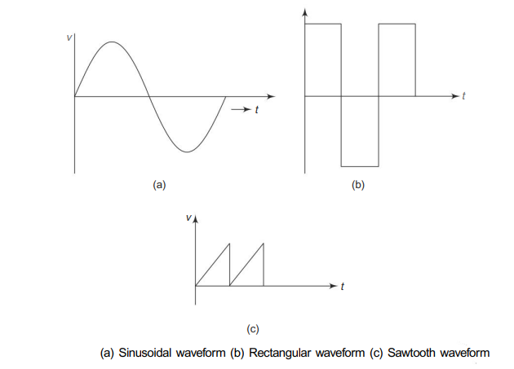
TERMINOLOGY
1. Waveform :A waveform is a graph in which the instantaneous value of any quantity is plotted against time. Examples of waveforms are shown in Fig.
2.Alternating Waveform: This is a wave which reverses its direction at regularly recurring intervals, e.g. Fig.

Slide 7
3. Periodic Waveform: Periodic waveform is one which repeats itself after definite time intervals.
4. Sinusoidal and Non-Sinusoidal Waveform Sinusoidal waveform :It is an alternating waveform in which sine law is followed. Non-sinusoidal waveform It is an alternating waveform in which sine law is not followed.
5. Cycle :One complete set of positive and negative halves constitute a cycle.
6. Amplitude: The maximum positive or negative value of an alternating quantity is called the amplitude.
7. Frequency: The number of cycles per second of an alternating quantity is known as frequency. Unit for frequency is expressed as c/s or Hertz (Hz).
8. Period (T): Time period of an alternating quantity is the time taken to complete one cycle. Time period is equal to the reciprocal of frequency. Time period is expressed in secs.
9. Phase :The phase at any point on a given wave is the time that has elapsed since the quantity has last passed through zero point of reference and passed positively.
10. Phase Difference: The term is used to compare the phase of two waveforms or alternating quantities

Slide 8
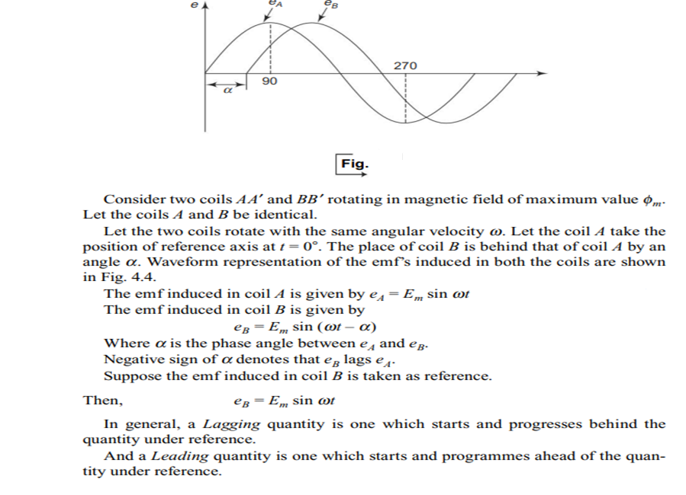

Slide 9
CONCEPT OF 3-PHASE EMF GENERATION
Definition and Computation: We have seen above only about single phase systems. Generally generation, transmission and distribution of electrical energy are of three phase in nature.
Three phase system is a every common poly phase system. It could be viewed as the combination of three single phase systems with a phase difference of 120° between every pair.
Generation, transmission and distribution of three phase power is cheaper. Three phase system is more efficient compared to single phase system. Uniform torque production occurs in three phase system whereas pulsating torque is produced in the case of a single phase system.
Because of these advantages, the overall generation, transmission and distribution of electrical power is usually of three phase. This chapter deals with the generation of 3-phase emf.

Slide 10
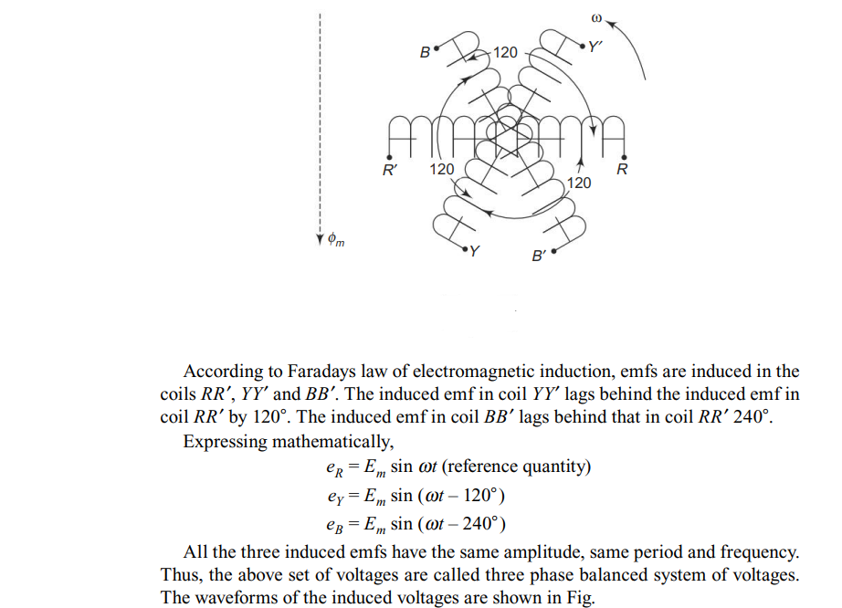
Generation of Three Phase emf
Consider three similar coils RR’, YY’ and BB’ placed in a magnetic field of maximum value Φ_{m} Webers. The coils are displaced by an angle of 120° in space between any two. Let all the coils rotate in the anticlockwise direction at an angular velocity ω.

Slide 11
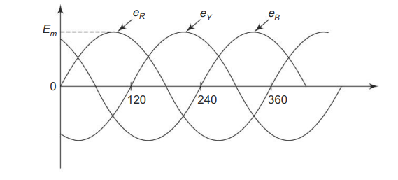

Slide 12
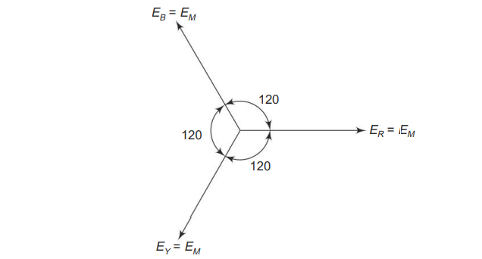

Slide 13
ROOT MEAN SQUARE (RMS) OR EFFECTIVE VALUE
Effective or RMS value of an alternating current is deifned by that steady value of current (dc) which when flowing in a given circuit for a given time produces the same heat as would be produced by the alternating current flowing in the same circuit for the same time.

Slide 14
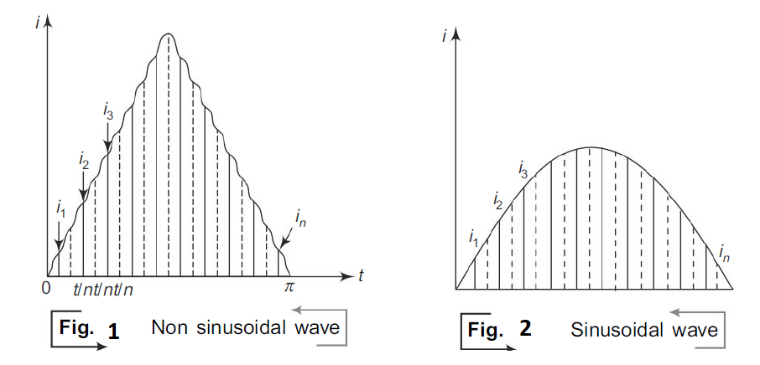
Determination of RMS Value for any Alternating Circuit
Figures (1) &(2)denote an alternating current wave during its positive half cycle for both symmetrical non-sinusoidal and sinusoidal waves. Divide the time base into n number of small intervals. Erect mid-ordintates in each interval.

Slide 15
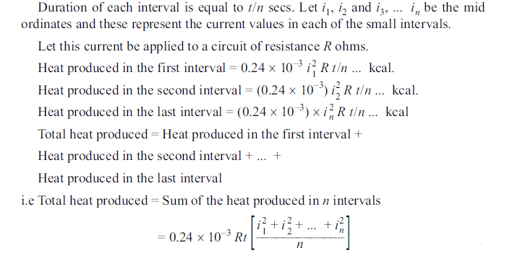

Slide 16
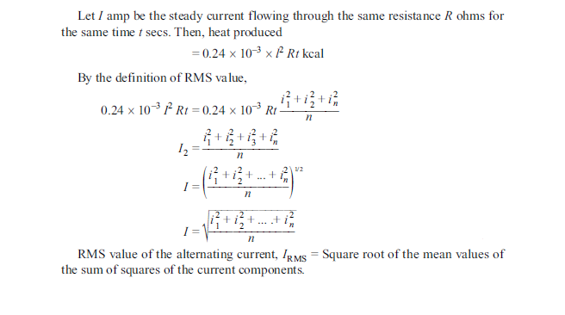

Slide 17
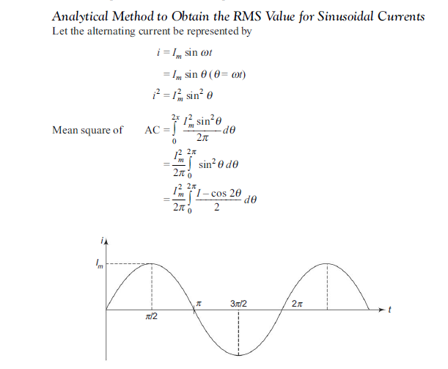

Slide 18
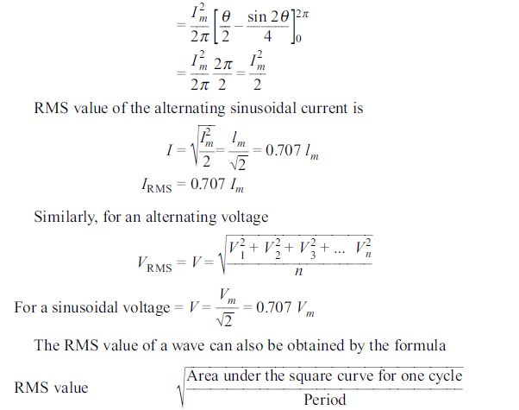

Slide 19
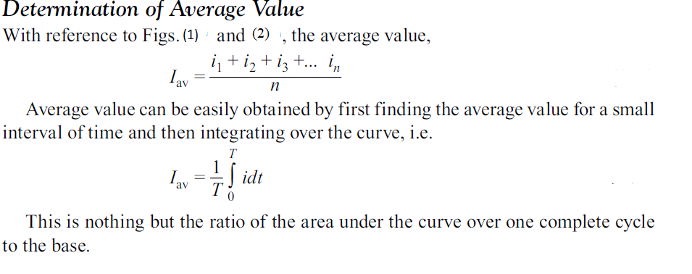
AVERAGE VALUE OF AC
Definition :
The average value of an ac is given by that steady current which transfers across a circuit the same charge as would be transferred by the ac across the same circuit in the same time.

Slide 20
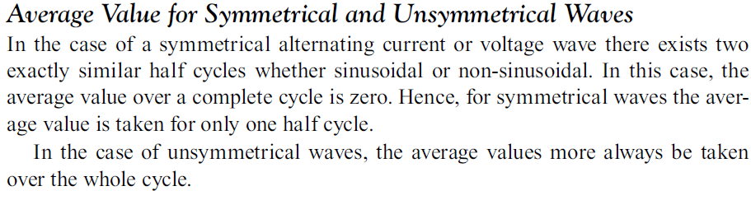

Slide 21
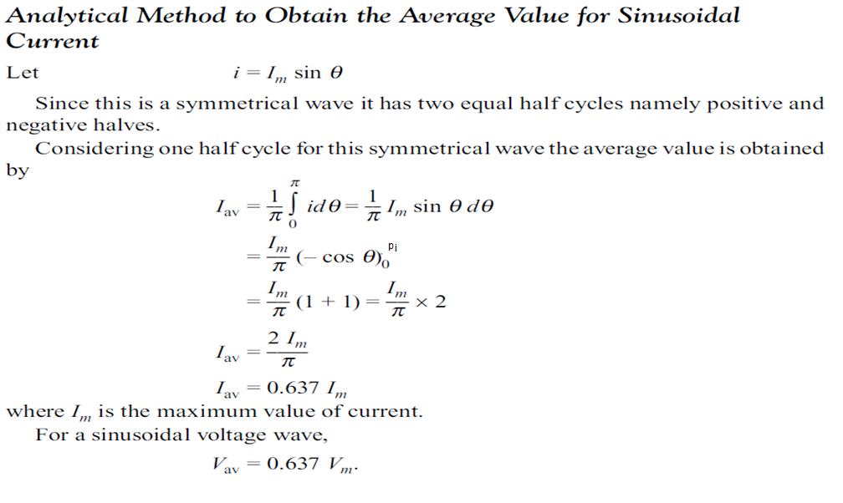

Slide 22
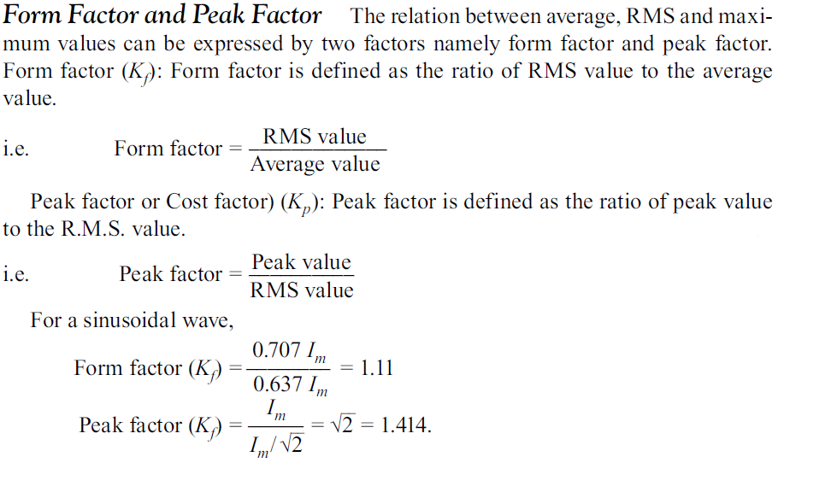

Slide 23
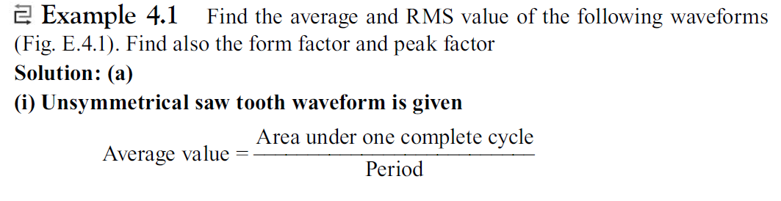
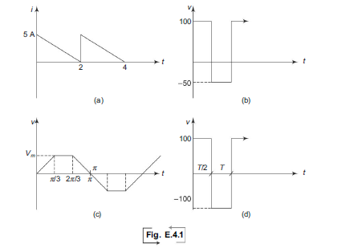

Slide 24
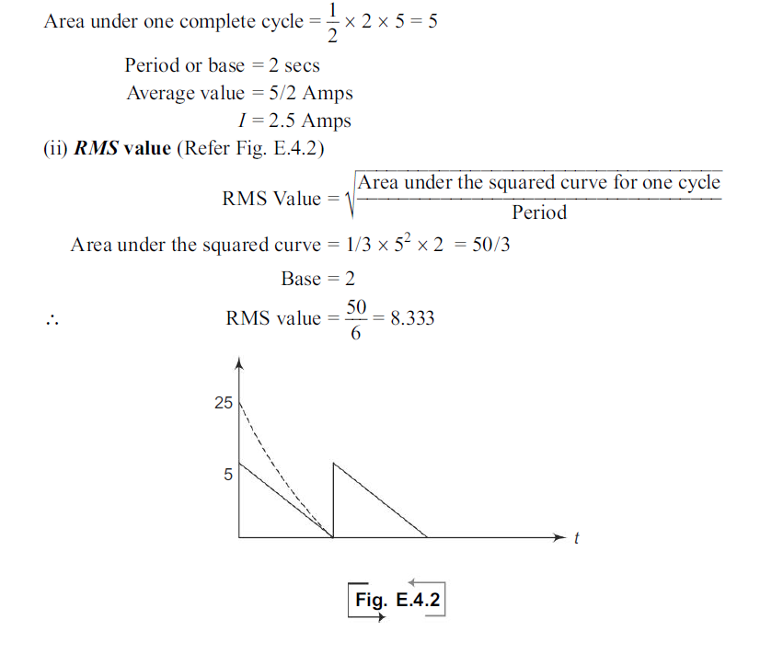

Slide 25
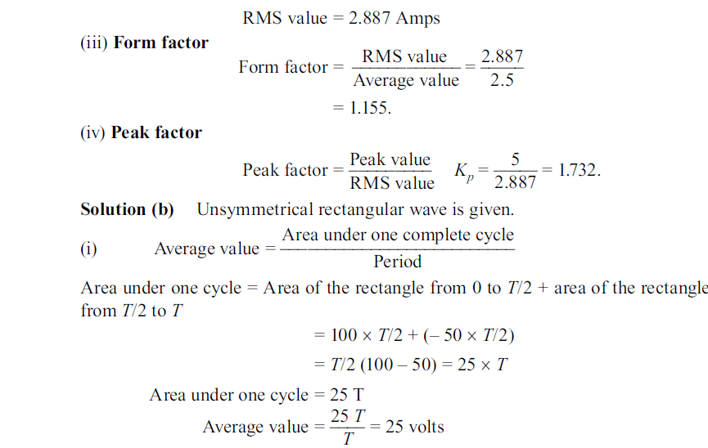

Slide 26
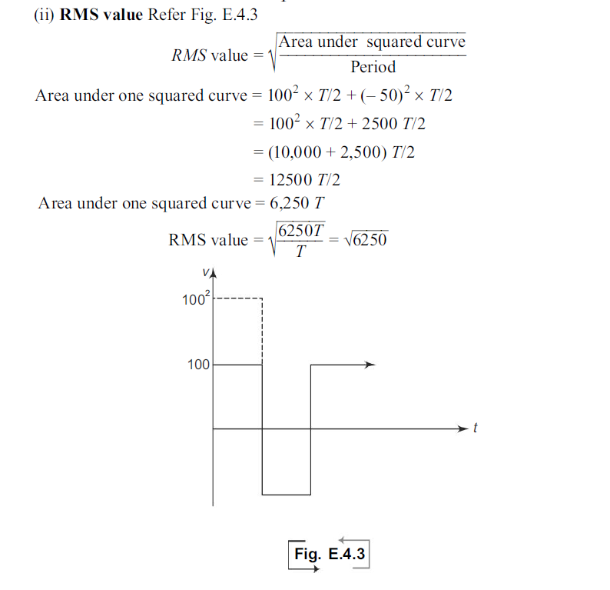

Slide 27
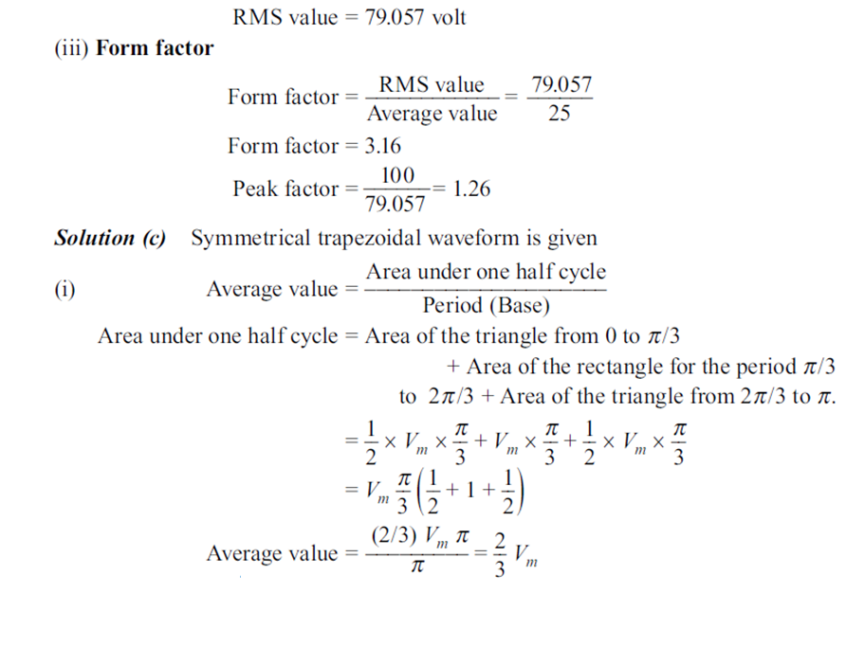

Slide 28
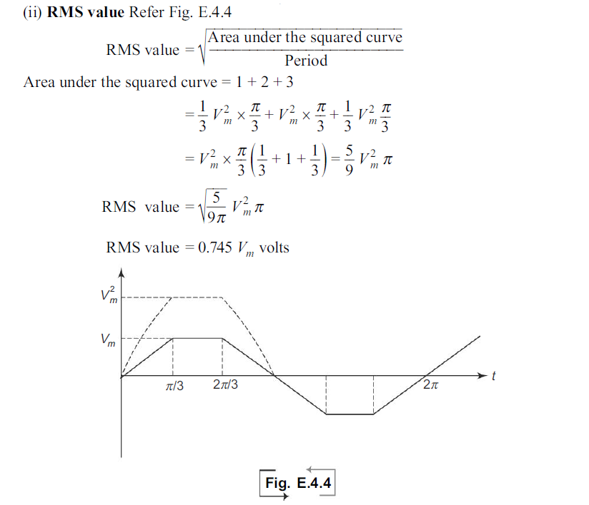

Slide 29
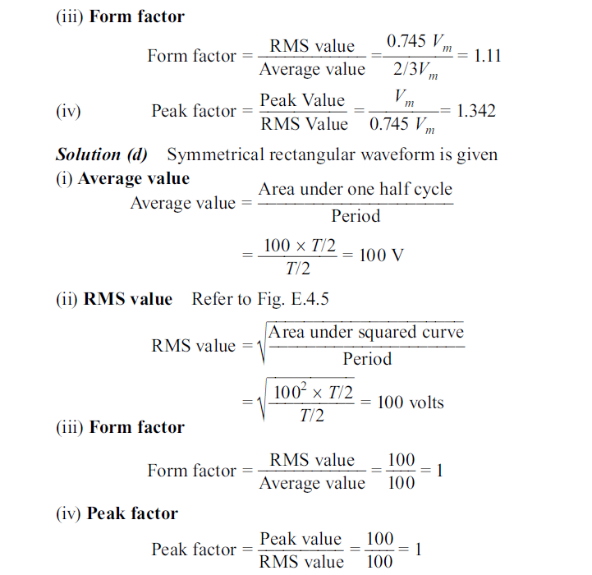

Slide 30
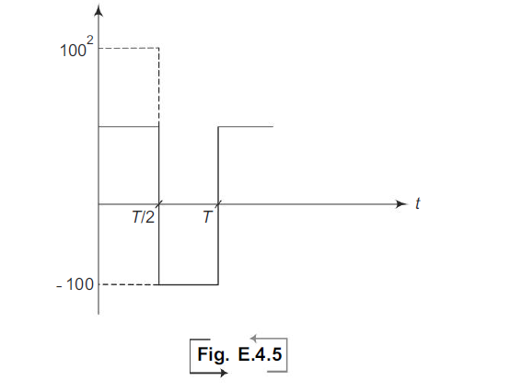

Slide 31
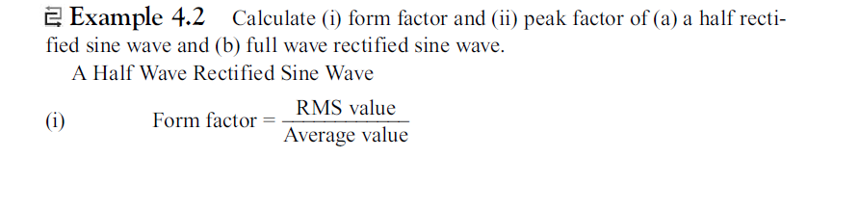

Slide 32
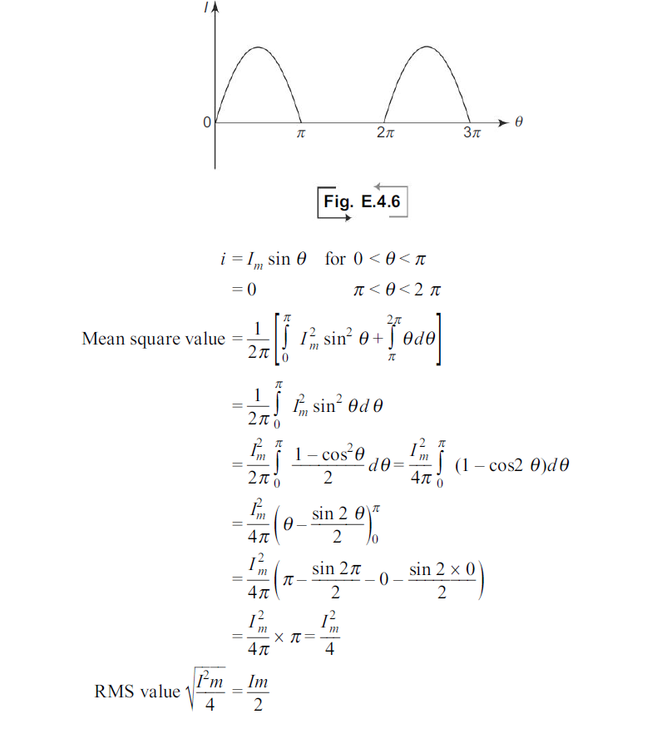

Slide 33
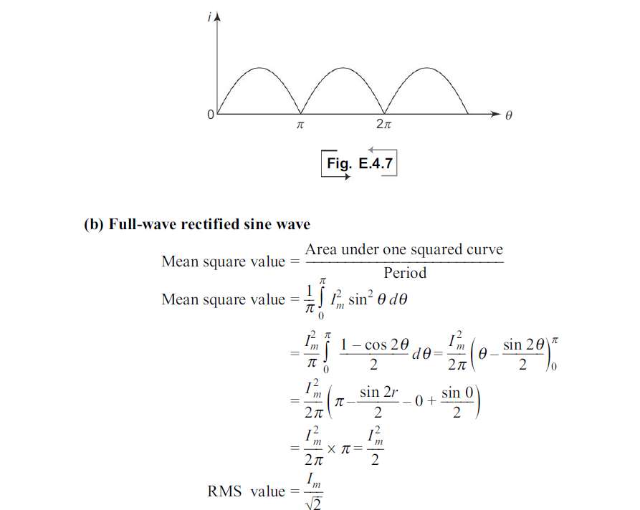

Slide 34
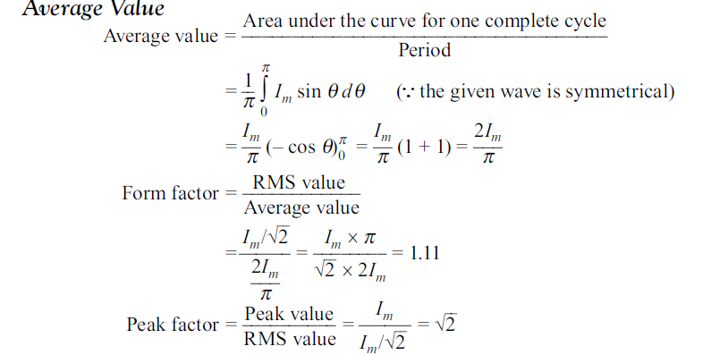

Slide 35
DC Machines
The broad based term, “Electrical Energy Systems Engineering” accounts for generation, transmission, distribution and utilization of electrical energy.
At every stage, different machineries are used each one of them serving specific purpose.
For example alternators used to generate alternating current (generation), transformers are used for stepping up and stepping down the voltage levels (transmission and distribution), dc motors, synchronous motors, stepper motors and induction motors all used in very many industrial and domestic applications.

Slide 36
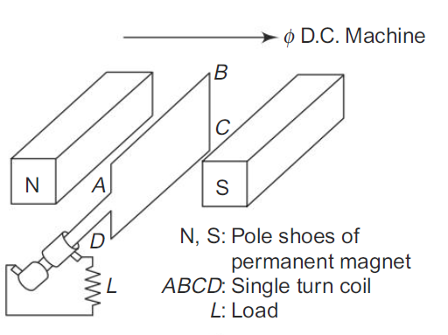
DC GENERATOR
Principle:
The generator is a dynamic machine in which mechanical energy is converted into electrical energy. It operates on the principle based on the Faraday’s Law of electromagnetic induction. The emf generated is to be classified as dynamically induced emf.
The basic requirements for the dynamically induced emf to exist are the following:
(i) A steady magnetic field
(ii) A conductor capable of carrying current
(iii) The conductor to move in the magnetic field

Slide 37
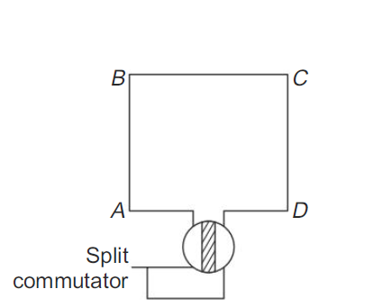
It shows a steady magnetic field produced by the pole pieces of a magnet N and S. A single turn coil ABCD is placed in the field produced between the pole pieces.
The coil is rotated by means of a prime mover. Thus,as per Faraday’s law, an emf is induced in the coil. Such an emf is basically alternating.
This bidirectional induced emf is made unidirectional using the commutator.

Slide 38
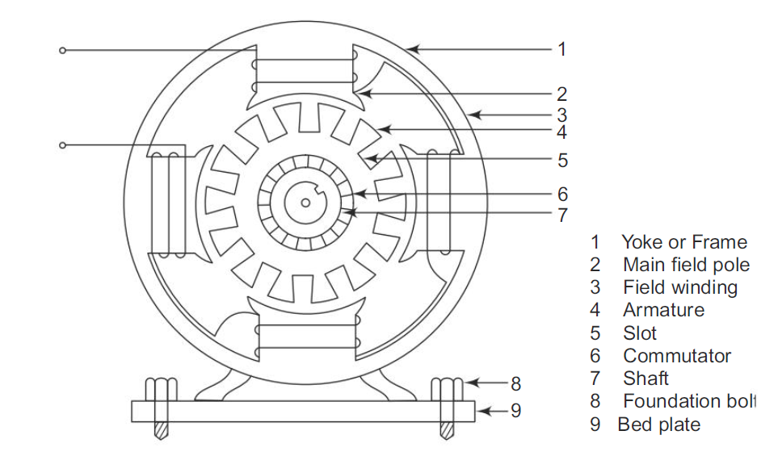
Construction of DC Generator:
For the satisfactory operation of a dc generator, it should consists of a stator and a rotor.
The stator accommodates the yoke, the main field system and the brushes. The rotor has the armature and the commutator as its main parts.

Slide 39
Yoke or Frame :It is the outermost solid metal part of the machine. It forms part of magnetic circuit and protects all the inner parts from mechanical damage.
Field System:This consists of main field poles and field winding. The field poles are made of laminations of a sutiable magnetic material. Such a magnetic material has very high relative permeability and very low hysteresis loss.
The pole face is in the form of horse shoe so that a uniform flux distribution is obtained in the air gap between the poles and the rotating part. The field winding is placed over the each pole and all these are connected in series.
Again the field winding is so arranged on the different poles that when a direct current is passed through this winding,the poles get magnetized to N and S polarities alternately. Thus, the field system isresponsible for producing the required working flux in the air gap.
Brushes :A set of brushes made of carbon or graphic are fixed such that they are always in gentle touch with the revolving armature. The generator is connected to external circuits by means of these brushes. Thus, the brushes are used to tap the generated electrical energy off the rotating part of the generator.
Armature: The armature of a dc generator is in the form of laminated slotted drum. Slots are provided over the entire periphery of the armature and these slots are cut axially, i.e. they are parallel to the shaft. In these slots are embedded armature conductors. All the conductors are series connected to form a single armature winding.
The conductors are bent at the rear end of the armature and are connected to the commutator segments at the front end otherwise called the connected end. This is shown in Fig.

Slide 40
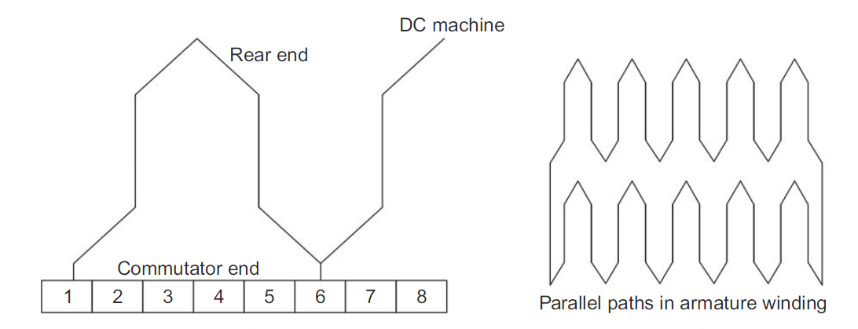

Slide 41
The armature winding may have two or more parallel paths depending on the type of winding used It is in those armature conductors mechanical energy is converted into electrical energy.
There are two ways an armature is wound.
(1) Wave winding: The number of parallel paths formed between the armature terminals is two irrespective of the number of poles.
(2) Lap winding: Here the number of parallel paths is to irrespective of the number of poles in the machine.
Commutator :The commutator is similar in shape to armature. But, it has less diameter than that of the armature. Required number of segments are provided over the complete periphery of the commutator.
There is an electrical insulation between every pair of segments. A minimum of two conductors are connected to each segment.
But, at the same time the two conductors making a single coil are connected to different commutator segments. The brushes are so placed that they are always keeping to such with the revolving commutator segments.

Slide 42
EMF Equation or Equation for the emf Generated:
Let P – Number of poles in the generator
f – flux per pole in webers
z – total number of armature conductors
A – Number of parallel paths formed by the armature winding between the armature terminals
A = 2, for wave wound armature winding
A = P, for lap wound armature winding
N – speed of rotation of armature in RPM
Eg – emf induced across the armature terminals or emf induced in any one parallel path of the armature winding.

Slide 43
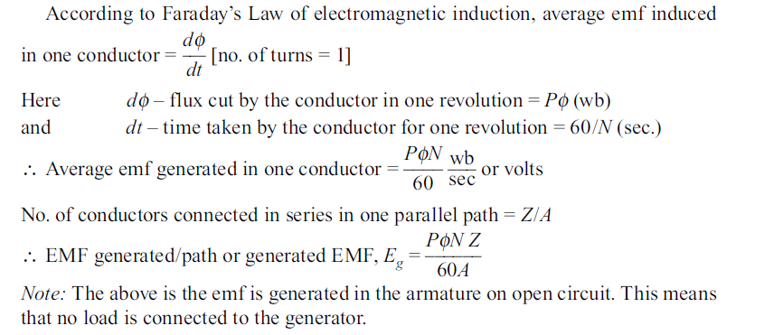

Slide 44
Types of DC Generator
Depending upon how the field windings are excited, dc generators can be classified as separately excited and self excited generators.
Separately excited generators receive the required electric power for their field system from a separate dc source.
Self excited generators receive the required power for their having system from the electrical power developed in their armature.
To avoid having a separate dc source, self excited generators are preferred. Depending upon the field winding connection with the armature winding and their location is the generator circuit, self excited generators can be classified as
(i) Shunt generators
(ii) Series generators
(iii) Compound generators

Slide 45
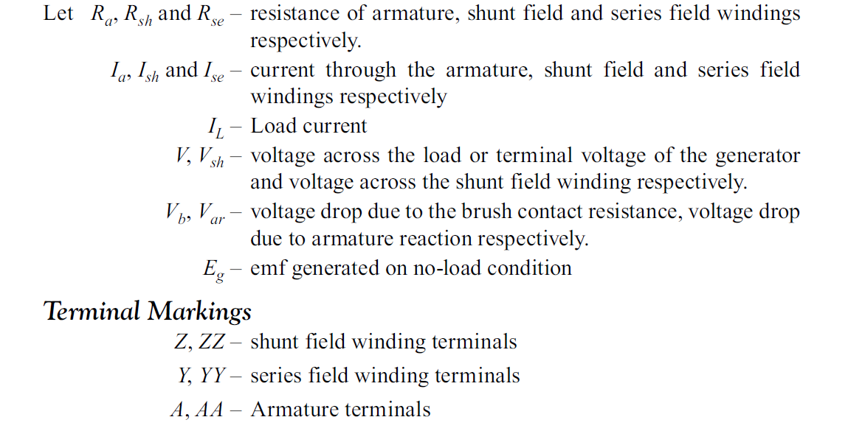
Electrical Equivalent Circuits, Current and Voltage Equations of DC Generators

Slide 46
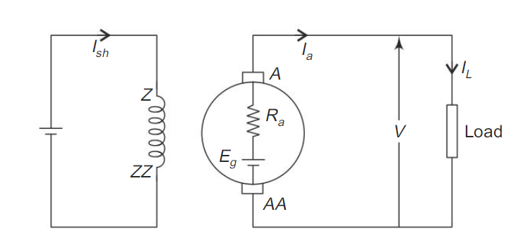
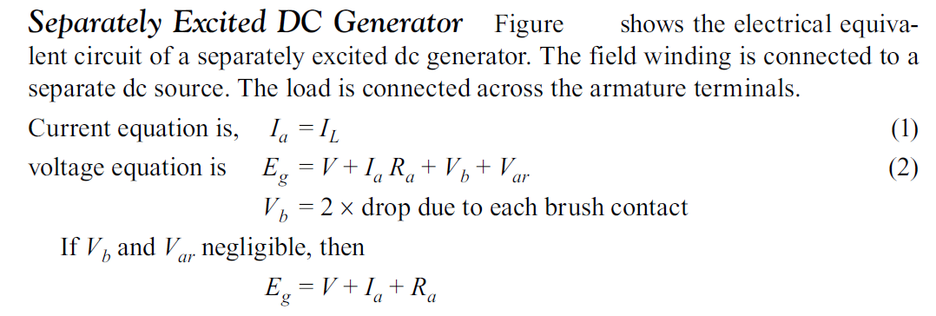

Slide 47
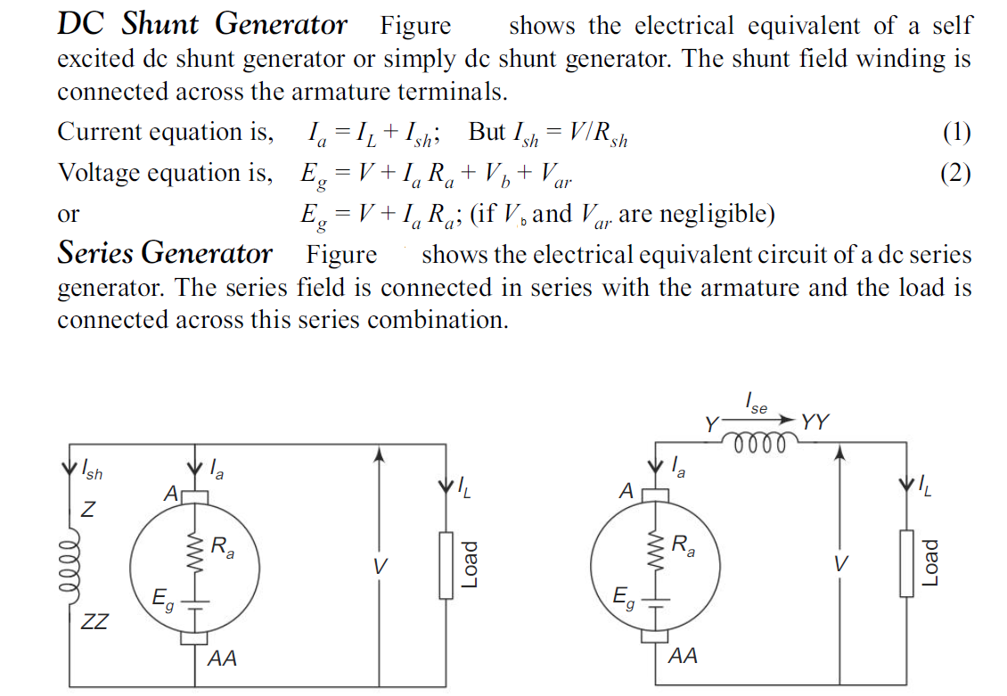

Slide 48
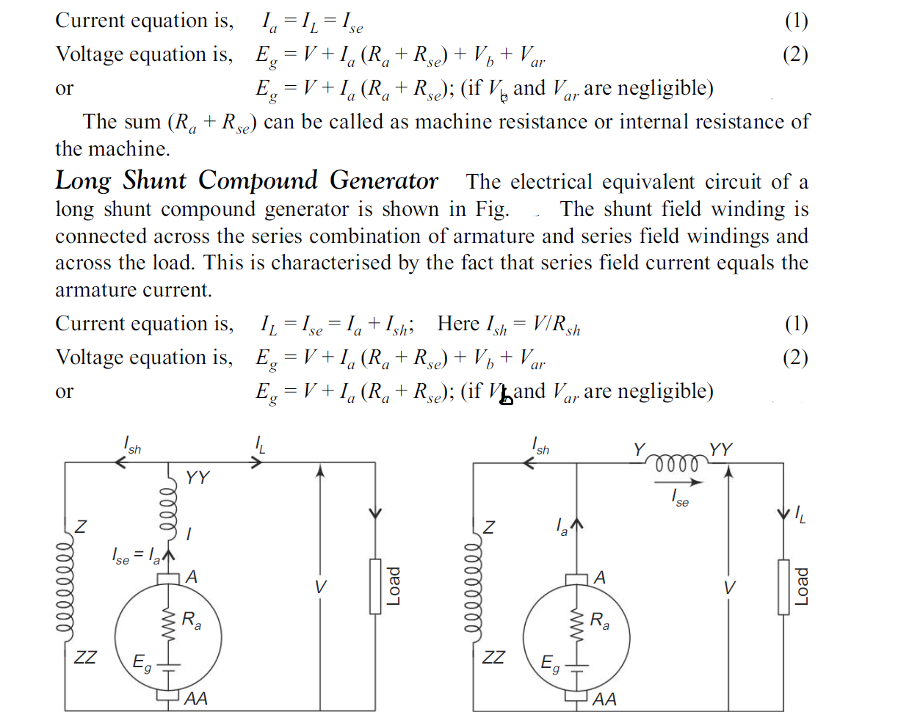

Slide 49
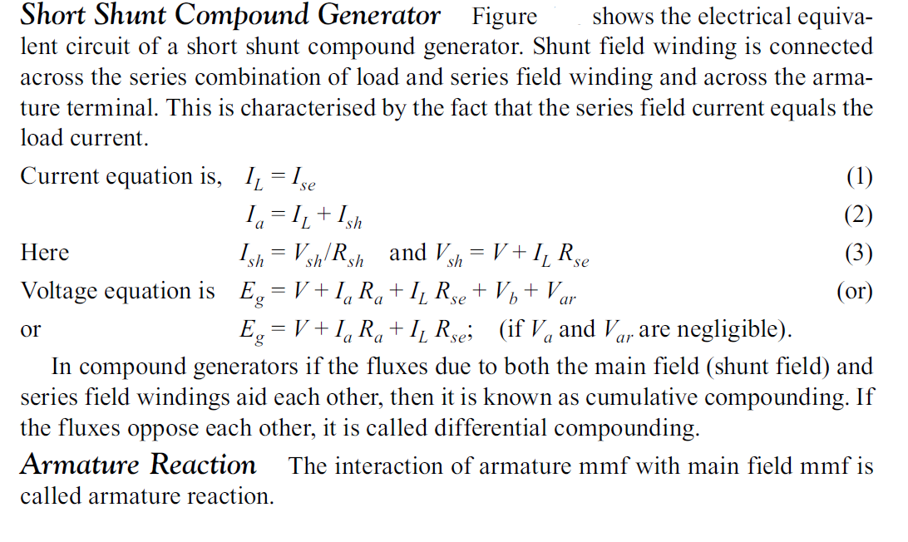

Slide 50
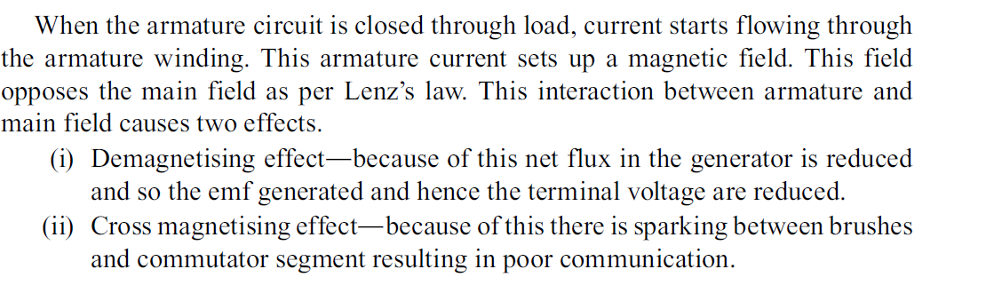

Slide 51
Applications of DC Generators
DC Shunt Generator:
1. Separately excited generators are preferred where the characteristics of dc shunt generators is not upto the expected level.
2. They can be used to excite the field magnets of ac generators.
3. A s the drop in voltage is very small, these generators can be used for supplying loads needing constant voltage.
4. They are used as source for battery charging purpose.
5. These generators are used for electroplating and electrolytic purpose.

Slide 52
Applications of DC Series and Compound Generators:
DC Series Generators
1. They are used for series arc lighting.
2. They are used for series incandescent lighting.
3. They are used as booster, for the purpose of compensating the drop in voltage
in the lines on loading.
4. Used for regenerative braking of dc locomotives.
Compound Generators
1. By means of compound generators it is possible to give constant voltage at
the line by proper compounding.
2. Differentially compounded generator may be used for welding purposes.
3. They are used to supply power to railway circuits, incandescent lamps,
elevator motors, etc.

Slide 53
DC MOTOR
Principle:
Whenever a current carrying conductor is kept in a stationery magnetic field an electromagnetic force is produced. This force is exerted on the conductor and hence the conductor is moved away from the field. This is the principle used in d.c. motors.
Construction
The construction of dc motor is exactly similar to dc generators. The salient parts of a dc motor are yoke or frame, main field system, brushes, armatures and commutator.

Slide 54
Working:
In a dc motor, both the armature and the field windings are connected to a dc supply.
Thus, we have current carrying armature conductors placed in a stationery magnetic
field.
Due to the electromagnetic torque on the armature conductors, the armature
starts revolving.
Thus, electrical energy is converted into mechanical energy in the armature. When the armature is in motion, we have revolving conductors in a stationery magnetic field.
As per Faraday’s Law of electromagnetic induction, an emf is induced in the armature conductors. As per Lenz’s law, this induced emf opposes the voltage applied to the armature. Hence, it is called the counter or back emf.
There also occurs a potential drop in the armature circuit due to its resistance. Thus, the applied voltage has to overcome the back emf in addition to supplying the armature circuit drop and producing the necessary torque for the continuous rotation of the armature.

Slide 55
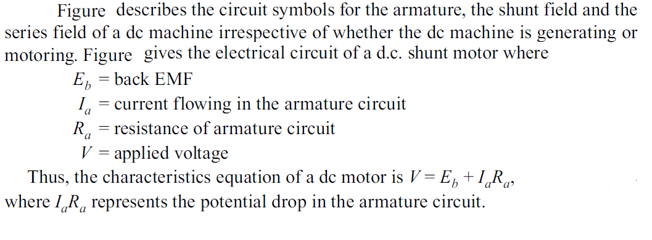

Slide 56
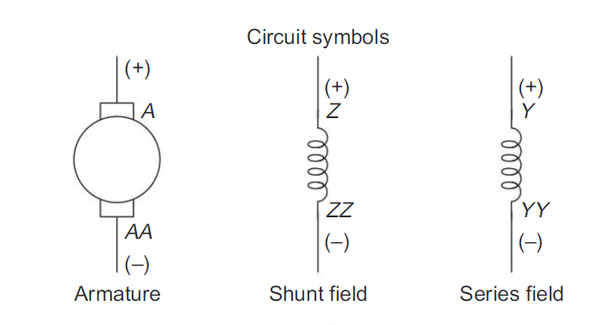
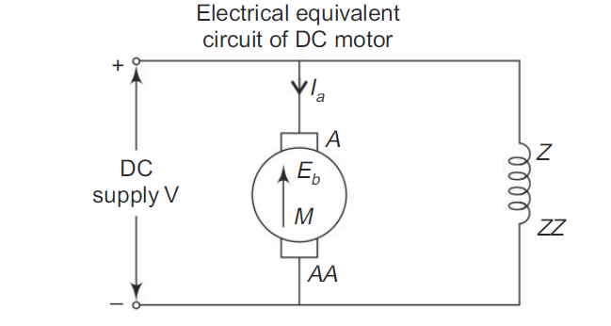

Slide 57
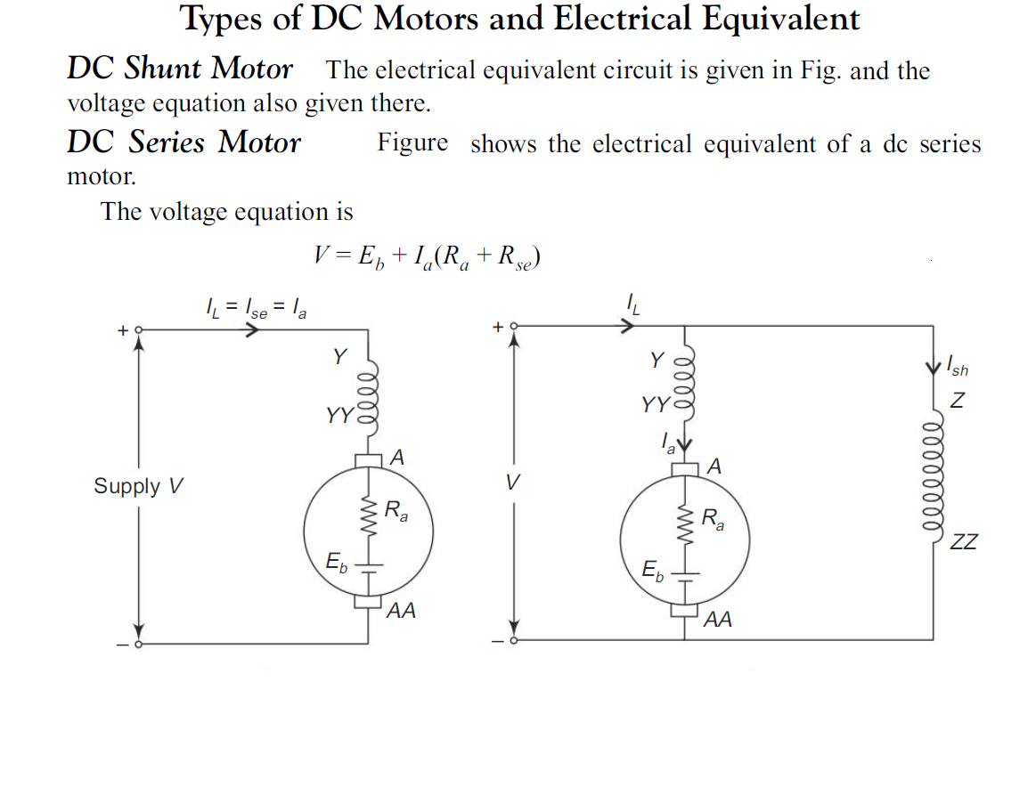

Slide 58
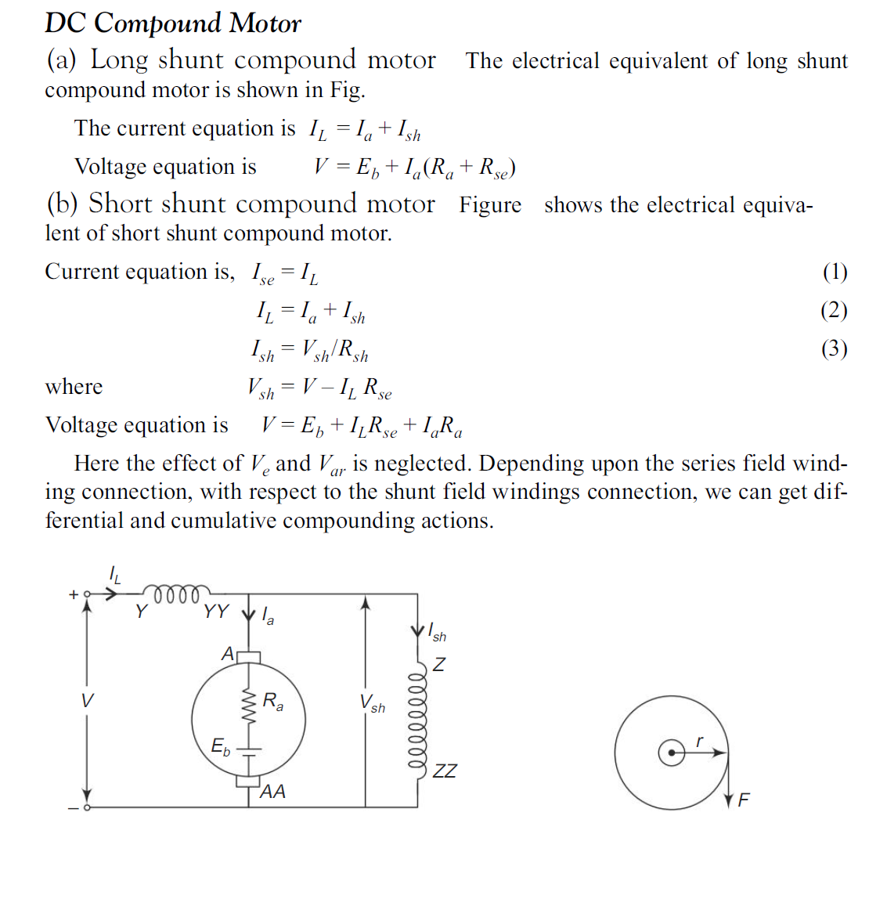

Slide 59
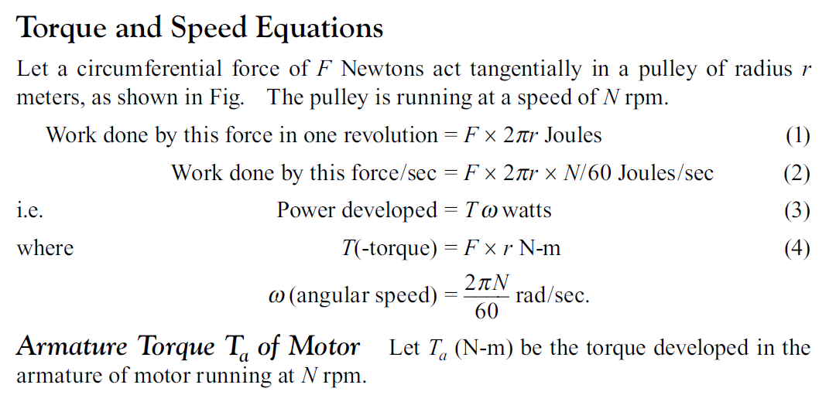

Slide 60
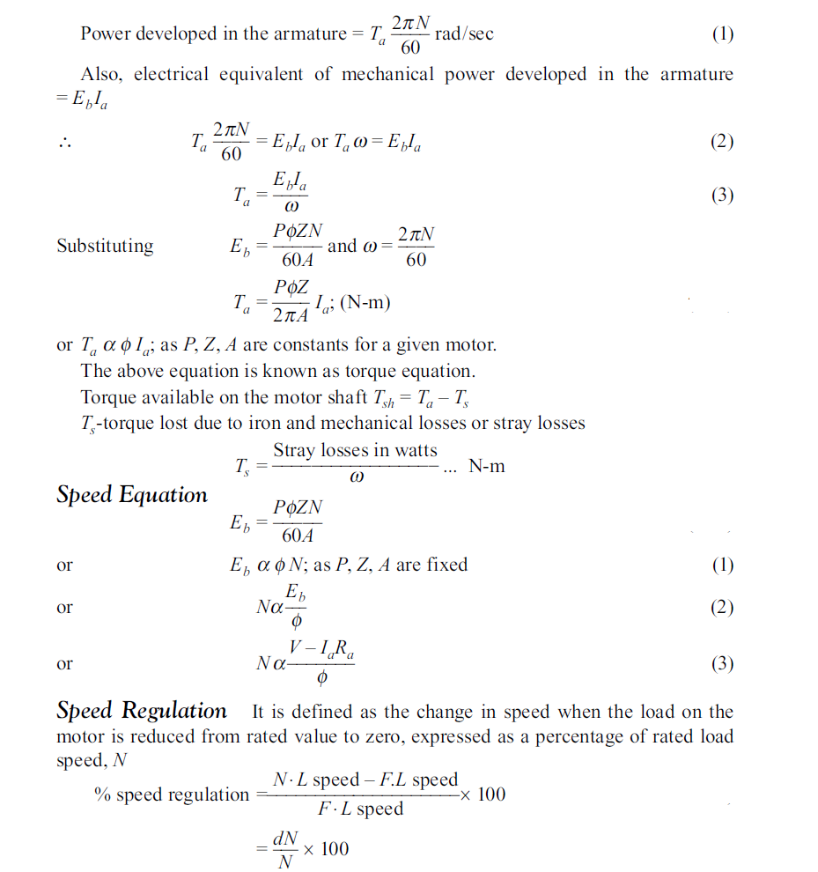

Slide 61
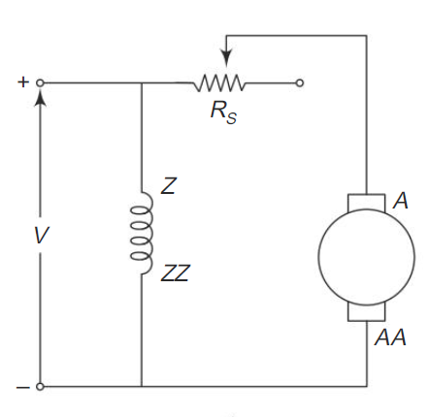
Starter:
If the motor is directly switched on to the supply, the current drawn by the motor will be many times its full load current. This is because at the moment of switching on, there is no back emf developed by the motor. So, the current drawn by the motor is controlled by its internal resistance which is very small in value.
This current is Ia =V/Ra which is sometimes around 25 to 30 times of full load current of motor. This starting current will affect the power system supply quality.
Specifically, there will be a heavy drop in system voltage momentarily. So, the starting current has to be limited. This can be achieved by connecting a resistance in the armature circuit.
Once the motor picks up speed the back emf is developed and so the external resistance can be gradually cut out from the circuit.

Slide 62
Need of Starter
To start the dc motor a device called starter can be used. The main function of the starter is to control the starting current drawn by the motor.
The main component of a starter is resistance Rs. In addition to this they have protective devices like no-voltage release coil and overload release coil.
There are 2-point starters meant for starting dc series motors 3-point and 4-point starters which are used for starting dc shunt and compound motors.
DC 3-point Starter:
When the starter handle is moved from OFF position to stud (1) of Rs, the armature circuit of motor is closed through the starting resistance Rs and the overload release coil [OLR coil], thereby the starting current is controlled.
Field circuit of motor is also closed through the voltage coil [NVC].
The motor starts running and back emf develops. Now the starter handle can be moved gradually from one stud to another and finally to ON.

Slide 63
The starter handle should be moved against the restraining force offered by the spring mounted in the starter handle.
Once the starter handle comes to ON position,the NVC holds the starter handle firmly, i.e. the electromagnetic attracts the soft iron piece attached to the starter handle.
Whenever supply fails, the NVC gets de-energised and the electromagnetic N is demagnetized. Because of spring “force, the starter” handle comes to OFF position.
When the motor is over loaded, electromagnetic force offered by the OLR coil is sufficient to attract the iron strip P.
The contacts CC are bridged which results in short circuiting of NVC. So in this case also the electromagnet. “N” is demagnetized and the starter handle comes to OFF position. In this way the motor is protected against failure of supply and against overloading.

Slide 64

The main drawback here is, under normal running condition of motor, the resistance Rs included in the field circuit, reduces the field current unnecessarily.
This results in less torque production and poor commutation. This problem is removed by attaching a metal plate in the form of an arc just below the starting resistance.
There is no electrical contact between this metal arc and the starting resistance. It is so positioned that when the handle touches stud 1 it also touches the metal arc through which the field gets the full voltage applied.
This three-point starter is not suitable in cases where the motor speed is controlled by weakening its field. This would result in de-energising of the no voltage release coil and so the handle will automatically come back to the OFF position.
This disadvantage is overcome in the 4-point starter. In that starter there is one more parallel circuit comprising of the brass strip, no voltage release coil and a series protective resistance. The field winding constitutes another parallel circuit having its own regulator.

Slide 65
DC Shunt Motor Applications
These motors are used wherever stable speed is required.
This kind of DC motor can be used in Centrifugal Pumps, Lifts, Weaving Machine, Lathe Machines, Blowers, Fans, Conveyors, Spinning machines, etc.
The applications of this motor mainly comprise machines instruments like grinders, latches & industrial tools like compressors as well as fans.
Application of DC Series motor:
Cranes.
Air compressor.
Lifts.
Elevators.
Winching system.
Electric traction.
Hair drier.
Vacuum cleaner and in speed regulation application.

Slide 66
Application of DC Compound motor
⇒ By compound motor, we get high starting torque and nearly constant speed. Because of that Compound motors are used where we require high starting torque and constant speed.
⇒ A compound motor is used in Presses, Shears, Conveyors, Elevators, Rolling Mills, Heavy Planners, etc.
Why D.C motors are used?
While some may claim that direct-current (DC) motors are no longer relevant, that is definitely not the case. DC motors and DC converters/drives are alive and well in the industry. D.C motors have some advantages like
Low construction cost
Speed control over a wide range
High starting torque
Quick Starting and Stopping, Reversing and Acceleration

